Slide 1
Fundamentals of Computing Programing Structures

Slide 2

Overview Of Operating System
An operating system (OS) is a set of programs that control the execution of application programs and act as an intermediary between a user of a computer and the computer hardware. OS is software that manages the computer hardware as well as providing an environment for application programs to run.
Examples of OS are: Windows, Windows/NT, OS/2, Ubuntu, MacOS etc...
An Abstract view:
Resource Manager
Controller (programs)
Simplify in application development
Acts as Government
User
Non Kernel
Kernel
Hardware

Slide 3
The Computer System
THE OBJECTIVES OF OS:
1. To make the computer system convenient and easy to use for the user.
2. To use the computer hardware in an efficient way.
3. To execute user programs and make solving user problems easier.

Slide 4

Types of Operating System
Batch OS
Multi Programing OS
Multi Tasking OS
Multi Processing OS
Real-Time OS
Batch OS :
Consist of Jobs (Program, input data, control instruction) in the form of punch cards
Non interact (user cannot interact with the OS)
Similar jobs are grouped and in a single batch
Batch
User 2
J1
J2
input
CPU
OS
output
Operator
User 3
Jobs
J3
J4
User 4
User1

Slide 5



Multi Programing OS
execute each process at a time
current executing process cannot be forcefully removed from CPU
Multi Tasking OS
Is an extension of multi programing
Can forcefully remove the currently executing process on the basis of time slots: time sharing or fair share.
Main memory
CPU
Terminate (output)
P3 P2 P1
P1
Execution
P1
P3 P2 P1
Execution

Slide 6
Multi Processing OS (Tightly Coupled)
extension of multi tasking OS
involves multi CPU’s
each process or task is processed in each CPU
P1
P2
P3
P4
p1
CPU 1
p2
CPU 2
p3
CPU 3

Slide 7
Real-Time OS (RTOS)
Definition:
A system is said to be Real Time if its required to complete its work and deliver its services on time.
This type of OS is bounded by time constrain and there are two types;
Hard Real Time - The process should be completed at the exact time (purely deterministic)
Soft Real Time – The should be completed within the time bound (timing is not important than the output)
Examples of Hard Real Time OS would be:
timed bomb
missile launching
airbags etc…
Soft Real time OS:
Personal Computer
Audio and Video Systems

Slide 8
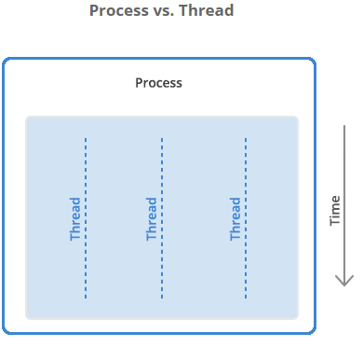
Processes and Threads
Definition:
Process – a program during execution is called a process.
Threads – basic unit of execution, or a collection of instructions formed together to produce a specific task.

Slide 9
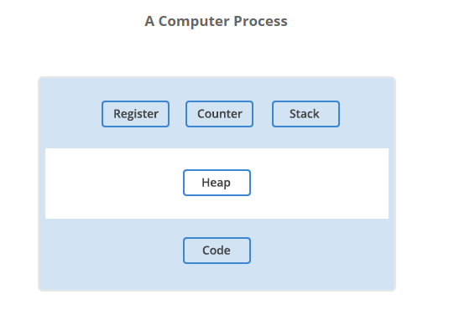
Process and how they work
The program loads into the computer’s memory in binary form. (heap)
“Registers” hold data for processing by computer’s processor (CPU)
The “Program Counter,” also called the “instruction pointer,” keeps track of where a computer is in its program sequence.
“Stack” is a data structure that stores information about the active subroutines of a computer program.

Slide 10
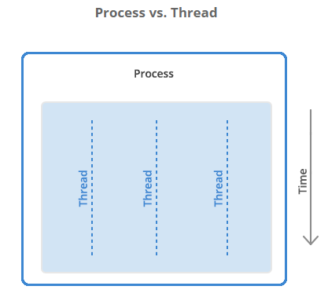
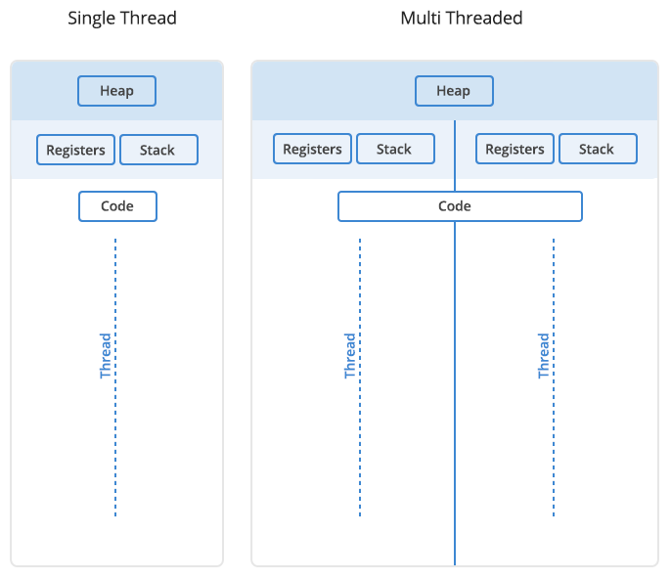
Threads and how they work
A Process may have one to many threads… Consider this examples.

Slide 11
Processes vs. Threads — Advantages and Disadvantages
Process | Threads
Processes are heavyweight operations | Threads are lighter weight operations
Each process has its own memory space | Threads use the memory of the process they belong to
Inter-process communication is slow as processes have different memory addresses | Inter-thread communication can be faster than inter-process communication because threads of the same process share memory with the process they belong to
Context switching between processes is more expensive | Context switching between threads of the same process is less expensive
Processes don’t share memory with other processes | Threads share memory with other threads of the same process

Slide 12
Process Vs Threads
So to review:
The program starts out as a text file of programming code,
The program is compiled or interpreted into binary form,
The program is loaded into memory,
The program becomes one or more running processes.
Processes are typically independent of each other,
While threads exist as the subset of a process.
Threads can communicate with each other more easily than processes can,
But threads are more vulnerable to problems caused by other threads in the same process.

Slide 13
Fundamentals of Computing – Software Concepts
Table of Contents
Programming concepts
Introduction
Program Structure
Variable Declaration
The Boolean Operators
Comparison Operators
Combining Boolean and Comparison Operators
Conditional Statements (IF..THEN..ELSE)
Iterative Constructs (Loops)

Slide 14
Introductions
Computer programs are collections of instructions that tell a computer how to interact with the user, interact with the computer hardware and process data.
Low Level Language-Machine Language
High Level Language-Ex. C,C++,Java
Compiler- A Software that is used to translate high level instruction into machine language.

Slide 15
Compiled Language Vs Interpreted Language
Higher level languages such as “C”, C++, Pascal, Cobol, Fortran, ADA and Java are called “compiled languages”. In a compiled language, the programmer writes more general instructions and a compiler automatically translates these high level instructions into machine language. The machine language is then executed by the computer.
In an interpreted programming language, the statements that the programmer writes are interpreted as the program is running. This means they are translated into machine language on the fly and then execute as the program is running. Some popular interpreted languages include Basic, Visual Basic, Perl, Python, and shell scripting languages such as those found in the UNIX, Linux and MacOS X environment.

Slide 16
Programing Concepts Examples
Computer Programing Languages can be classed into three (3) different categories of computer languages: Machine language, Assemble language and High-Level language
Machine Language
Native language of a particular computer
Instructions are in Binary form ( 1s and 0s)
All language are translated to machine language
Example:
X = X + 1 mathematical notation
1010 0001 1110 0110 0000 0001
0000 0011 0000 0110 0000 0001 0000 binary notation
0000 1010 0011 1110 0110 0000 0001

Slide 17
Programing Concepts (cont…)
Assembly Language
uses English-like abbreviations to represent operations performed on the data.
must be translated into machine language with the help of the special program called an assembler.
Example:
MOV AX, [01E6]
ADD AX, 0001
MOV [01E6], AX
increasing the value of the variable by 1 as well. This example is also specific to an Intel processor.

Slide 18
Programing Concepts (cont…)
High-Level Language
uses English-like instructions and common mathematical notations.
allow programmers to perform complicated calculations with a single instruction
easier to read and understand than machine and assembly languages
not as time-consuming to create a program in high-level language as it is in machine or assembly language
Example:
variable := variable + 1;

Slide 19
Introduction
Computer Programs (softwares) and Languages:
set of instruction executed by a computer to perform a task
non physical part of the computer but very important
There are different types of programs developed from different types of computer language
Two different types of Softwares:
System software
Application Software
Softwares are developed from different languages

Slide 20
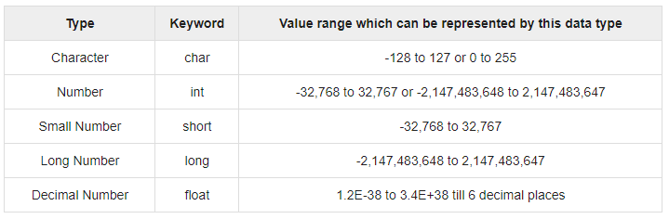
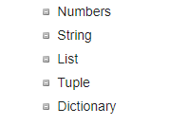
Program Structure
Definition:
A collection of different datatypes, variables, grouped together under a single name.
Examples of Different datatypes:
C, C++, Java datatypes Python Datatypes

Slide 21
Structured Programming Vs Object Oriented Programming
In structured programming, blocks of programming statements (code) are executed one after another. Control statements change which blocks of code are executed next.
In object oriented programming, data are contained in objects and are accessed using special methods (blocks of code) specific to the type of object. There is no single “flow” of the program as objects can freely interact with one another by passing messages.

Slide 22
Program Structure
The same structure is followed by all structured programs :
Statement to establish the start of the program
Variable Declaration
Program Statements(blocks of code)

Slide 23
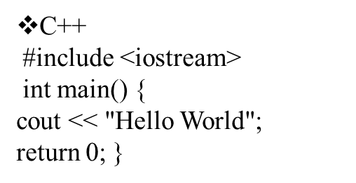
Examples
C
#include <stdio.h>
void main() {
printf("Hello World");
}
Java
class helloworld { public static void main (String args [])
{ System.out.println ("Hello World"); } }
Basic
print "Hello World"

Slide 24
Variable Declaration
Variables are place holders for data a program might use or manipulate.
Variables typically store values of a given type. Types generally include:
Integer – to store integer or “whole” numbers
Real – to store real or fractional numbers (also called float to indicate a floating point number)
Character – A single character such as a letter of the alphabet or punctuation.
String – A collection of characters

Slide 25
Examples
C #include <stdio.h> void main() { int age; float salary; char middle_initial; age = 21; salary = 29521.12; printf("I am %d years old ", age); printf("I make %8.2f per year " salary); } | Java class myexample { public static void main (String args []) { int age; double salary; age = 21; salary = 29521.12; System.out.println ("I am " + age + " years old "); System.out.println ("I make " + salary + " per year"); }

Slide 26
Boolean Logic and Boolean Algebra
Boolean Algebra was invented by nineteenth century mathematician George Boole.
Only two answers are possible for Boolean Algebra : True or False.
Boolean logic is called a Two Valued Logic because an expression may only take on one of two values: True or False.
An expression is some collection of logical operands and logical operators that are combined together.

Slide 27
Continue…
In Arithmetic,
Operands: Numbers
Operators: Addition, Subtraction, Multiplication and Division
In Boolean Logic,
Operands: Statements
Operators: Logical AND , OR and NOT

Slide 28
Boolean Operator
There are three Boolean Operators : AND , OR and NOT. These operators are written differently depending on the language being used.
Language | AND | OR | NOT
C or C++ | && | || | !
Java | & | || | !
Basic | AND | OR | NOT

Slide 29
Continue…
The Boolean operators are evaluated in the following fashion.
For the AND operator, the combination of two “True” values results in “True” all other combinations evaluate to False.
For the OR operator, as long as one of the value is True, then the expression evaluates to True.
The NOT operator is called the “complimentary” operator. It reverses the truth value of the operand.

Slide 30
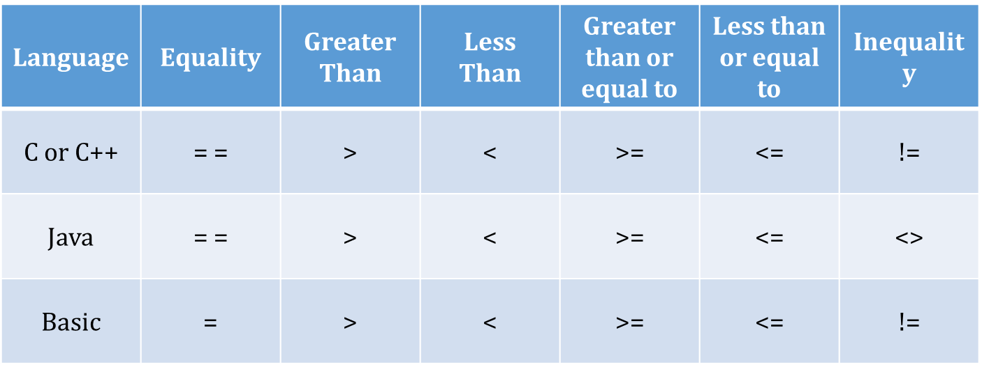
Comparison Operators
Boolean expressions often involve comparison operators that can be evaluated to determine if they are True or False.
Comparison Operators include:
= , < , > ,>= , <= , !=

Slide 31
Combining Boolean and Comparison Operators
All employees belong to a department
All employees working in department 5 have salaries greater than $25,000
All employees in department 4 make exactly $40,000 per year.
Alice is an employee and she works in department 5
Bill is an employee and he works in department 4
Expressions
Alice_salary < 25000 OR Alice_Department = 4
Alice_salary >= 25000 AND Bill_department = 4
Alice_salary < 25000 OR Bill_Salary < 40000 OR Alice_Department = 5

Slide 32
Conditional Statements(If..Then..Else)
Control statements “control” which sections of code in a program will be executed.
There are 3 types of Control Statements:
Sequential – The default ordering of execution
Decision (Conditional) – controls which block of code within several alternatives is executed.
Iterative – controls how many times a block of code is executed.

Slide 33
Example for Control Statements
Language | Example Program
“C” or C++ | #include <stdio.h> main() { int department; department = 5; if (department == 5) { printf("Employees should be paid more than 25,000"); } else { printf("Employees should be paid exactly 40,000"); } }
Java | class myexample { public static void main (String args []) { int department = 5; if (department == 5) { System.out.println ("Employees should be paid more than 25,000"); } else { System.out.println ("Employees should be paid exactly 40,000"); } } }

Slide 34
Iterative Constructs (Loops)
All programming languages have a facility to allow a section of code to be repeated (iterated or looped).
Looping Constructs fall into two categories: FOR loops and WHILE/DO loops.

Slide 35
FOR Loops
Simple FOR loops iterate a specific number of times based on counting up (or down) on an integer variable. For example, if we want to do something 10 times, we can make a loop that counts up from 1 to 10 and put our code inside the loop.
The three main parts that need to be written for a FOR loop are :
Initialization (the initial or starting value)
Condition (the condition under which the loop will stop)
increment (or decrement).

Slide 36
WHILE and DO Loops
Like FOR loops, the WHILE and DO loops are also used to repeat a section of code for some number of times. However while FOR loops basically specify some count, WHILE and DO loops repeat while a condition is true.
The condition is a boolean expression that we can evaluate as either "true" or "false". As soon as the condition evaluates to "false" the loop ends.
The main difference between a WHILE loop and a DO loop is where the condition is checked. WHILE loops check the condition first, and then run the statements if true. DO loops run the statements first, then check if the condition is true.

